Slide 1
Minimize Risk in Credit Card Transactions
Presented By:
David Musili
Griffin Roberts
Michael Lima
March 4th, 2024

Slide 2

Agenda
01. About Us
02. Our Clients
Provide an overview of our company
Discuss the solutions that we provide
03. Our Solutions
04. Model Demo
05. Data Analysis
06. Conclusion
TBD
TBD
.
TBD
TBD
February 28, 2024

Slide 3
1. About Us
DataInsight Solutions is a dynamic startup at the forefront of harnessing the power of data science to drive innovation and informed decision-making.
Founded by a team of experienced data scientists and industry experts, we offer cutting-edge solutions to unlock the full potential of data for businesses across various sectors.
From predictive analytics to machine learning and AI-driven insights, we empower our clients to extract actionable intelligence from their data, enabling them to stay ahead in today's rapidly evolving digital landscape.
Our commitment to excellence, coupled with a passion for solving complex challenges, sets us apart as the trusted partner for organizations seeking to leverage data as a strategic asset. At DataInsight Solutions, we turn data into value, transforming businesses and shaping the future of industries.
February 28, 2024

Slide 4



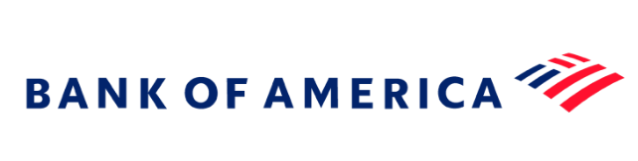

2. Our Clients
February 28, 2024

Slide 5

2. The Problem
Presenter: TBD

Slide 6
Problem Statement
The challenge is to recognize fraudulent credit card transactions so that the customers of credit card companies are not charged for items that they did not purchase. Main challenges involved in credit card fraud detection are:
Enormous Data is processed every day and the model build must be fast enough to respond to the scam in time.
Imbalanced Data i.e. most of the transactions (99.8%) are not fraudulent which makes it really hard for detecting the fraudulent ones
Data availability as the data is mostly private.
Misclassified Data can be another major issue, as not every fraudulent transaction is caught and reported.

Slide 7

3. DataInsight’s Solution
Presenter: TBD

Slide 8
Data Insight’s Solution
Data Insight’s solution has created simple and fast enough model to detect the anomaly and classify it as a fraudulent transaction as quickly as possible.
Imbalance is dealt with by properly using appropriate methods.
For protecting the privacy of the user the dimensionality is reduced.
4. The model is simple and interpretable so that when the scammer adapts to it with just some tweaks we can have a new model up and running to deploy.

Slide 9

3. Our Solution
Presenter: TBD

Slide 10

Source Files
1. creditcard.csv
Credit Card data
Acknowledgements
The csv files noted above were downloaded from Kaggle.

Slide 11
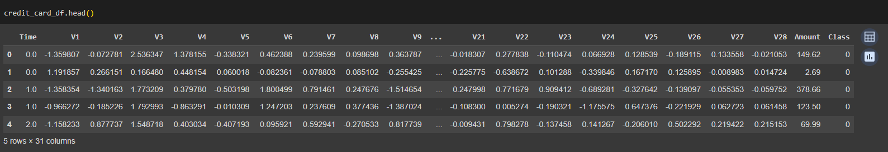
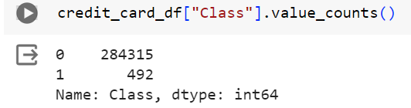
Data Exploration Process
How did we explore the data?
The data was already anonymized
The data had more valid transactions than fraud transactions

Slide 12
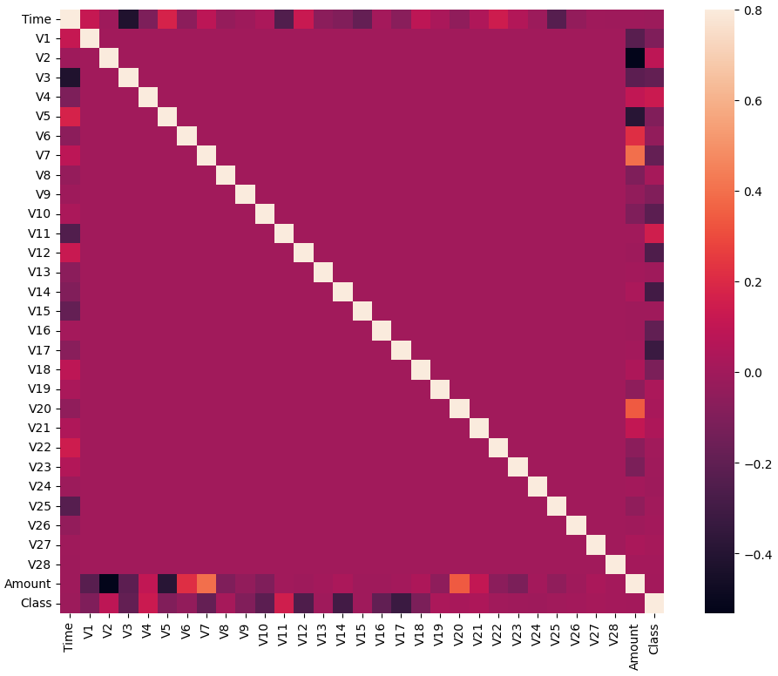
Data Exploration Process (contnd)
How did we explore the data?
3. There is minimal correlation

Slide 13
Data Preprocessing
How we cleaned up the data
We dropped the time from the X data and separated the target
We split the training and test data
We scaled the data MinMaxScaler
Used oversampled data on the training data

Slide 14

Model Perfomance

Slide 15
Models
Model | Training Score | Test Score | Recall (fraudulent) | F1 (non Fraudulent) | F1 Macro Average
Decision Tree Classifier
Random Forest
K-Nearest Neighbor
Support Vector Classifier
XG Boost
ADA Boost Classifier | 0.9993 | 0.9993
Logistic Regression | 0.9991 | 0.999
Gradient Boosting Classifier | 0.9992 | 0.9989

Slide 16
TBD
TBD

Slide 17
TBD

Slide 18

4. Conclusion
Presenter: Sam Farrow

Slide 19
5. Conclusions
1. Days with the most flight delays.
Delays are more likely to occur on Thursday, Friday or Monday flights.
2. Southwest Airlines has the most delays
Based on the data, Southwest Airlines had 75% more delays than its closest competitor (Delta Airlines)
3. Most of Southwest delays are due to its fleet arriving late
As compared to other airlines, Southwest delays are due to its flee arriving late.
4. Weather and Security delays are far fewer than is typically reported by the news media.
Compared to other types of delay, our data shows that weather and security delays are the least type of delays.
5. Saturday’s are the best day to travel, due to the minimal amount of delays.
If you are considering booking a flight, the best day to take the flight is on Saturday,.
6. Mondays and Tuesday tend have the most cancelled flights of the week.
Passengers intending to book flights on these days may prefer to book the flights on a different day in a bid to avoid the flight from being cancelled..

Slide 20

Thank you

